Slide 1
Drowsiness Detection
Group 1 [Review 02]

Slide 2
Table of contents
01
02
03
04
Contributions
Project Descriptions
Implementation
Results & Conclusions

Slide 3
01
Team Contributions

Slide 4
Mitali Rawat
22BAI10429
Data Processing
Yamini Masand
22BAI10426
Contributions
Amankumar Verma
22BAI10014
Model Training & Real-time Analysis
Simar Kochar
22BAI10012
Model integration & Alert mechanism
Arin Balyan
22BAI10041

Slide 5
Our Team
Mitali Rawat
22BAI10429
Dataset Labeling and Preparation
Yamini Masand
22BAI10426
Contributions
Amankumar Verma
22BAI10014
Model Training & Real-time Analysis
Simar Kochar
22BAI10012
Model integration & YOLO
Arin Balyan
22BAI10041

Slide 6
02
Project Description

Slide 7
01
Dataset pre-processing
Collect diverse alert/drowsy image dataset.
02
Processing
Real-time video processing with OpenCV.
03
Model Implementation
Keynotes
Implement drowsiness detection.
Deep drowsiness detection model based on machine learning that can be used in various real-time situations with different integrations.
04
Alert System
Alert mechanism based on the confidence level of prediction of drowsiness

Slide 8
03
Implementation Timeline

Slide 9
Import Pytorch
Install requirement.txt for YOLOv5
01
03
02
04
Clone yolov5 repository from Github
Import torch, matplotlib, pyplot, numPy, cv2 modules in workspace

Slide 10
Load model using Pytorch
Real-time detections using open cv
05
07
06
08
Image detections and plot using matplotlib
Import os, time, and uuid modules

Slide 11
Training Model from scratch using Open cv
Customizing model for drowsiness detection specifically
09
11
10
12
Labelling dataset and resource planning
Alert Mechanism based on confidence level

Slide 12
Results

Slide 13
Model Evaluation
Accuracry
Error
0%
100%
0%
100%
xDrowsiness Detected: 72%
xDrowsiness not detected: 28%
In our testing conducted within our coding environment, our Drowsiness Detection Model demonstrated an accuracy of 72% in detecting drowsiness. This promising result underscores the reliability and effectiveness of our model in real-world use cases.
In our testing within the coding environment, our Drowsiness Detection Model exhibited a 28% error rate in drowsiness detection. While we continue to enhance its performance, this margin of error serves as a valuable benchmark for further refinement and optimization.

Slide 14
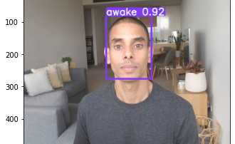
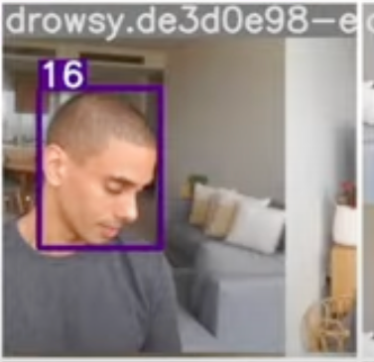
Metrics

Slide 15
Thanks!

